Slide 1
SQL API Project
Flights and weather during hurricane Barry 2019
2022-12-06 - Jugnu, Sara, Martin, Nora

Slide 2
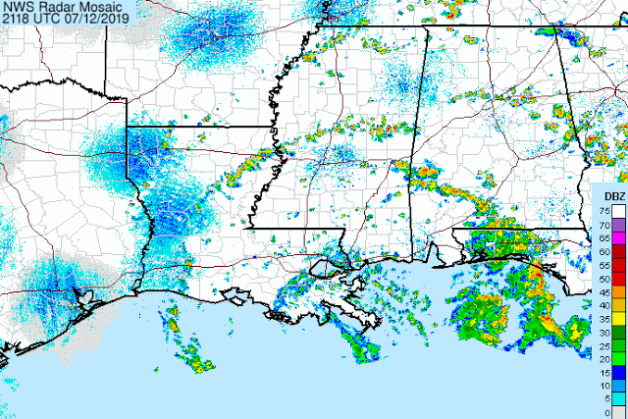


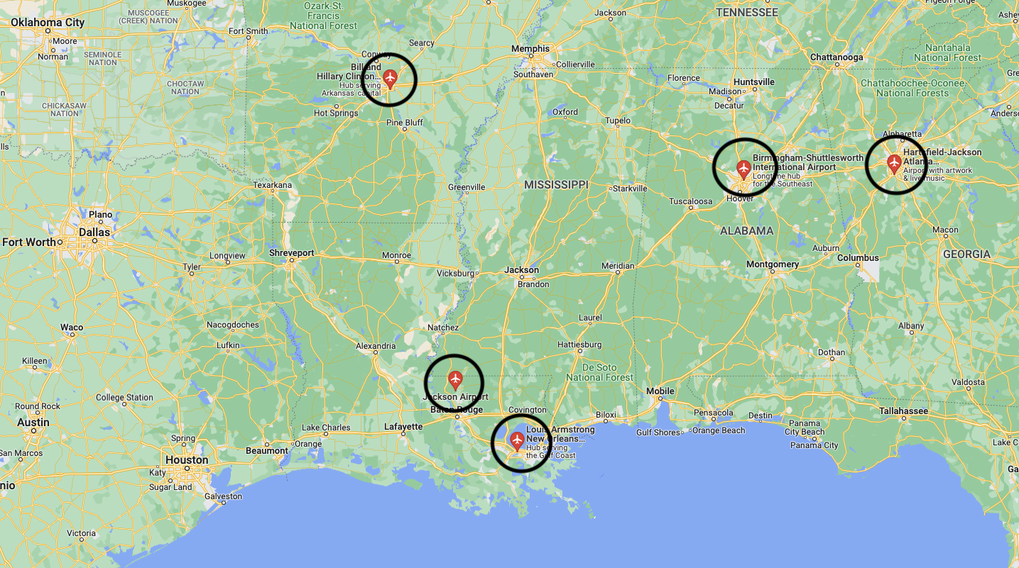
Decided for hurricane Barry
Category 1 hurricane
11 to 15 July 2019

Slide 3




Create flights / weather table with data from July 2019
Downloaded and extracted in VS Code
Pushed prepared data to a table
Cleaned columns and data types
Joined with airport table in DBeaver

Slide 4
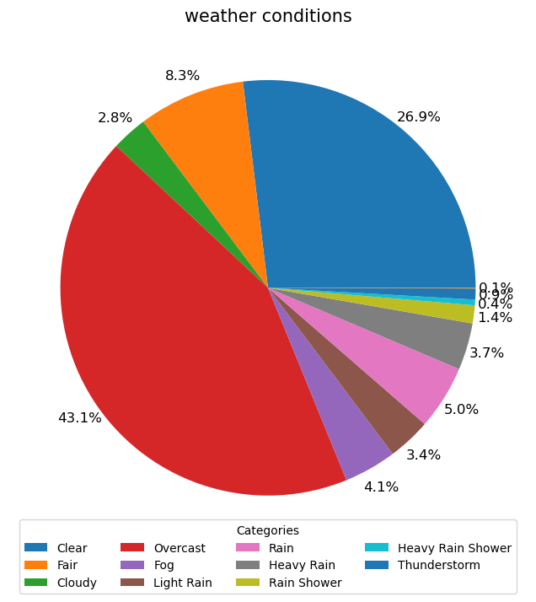
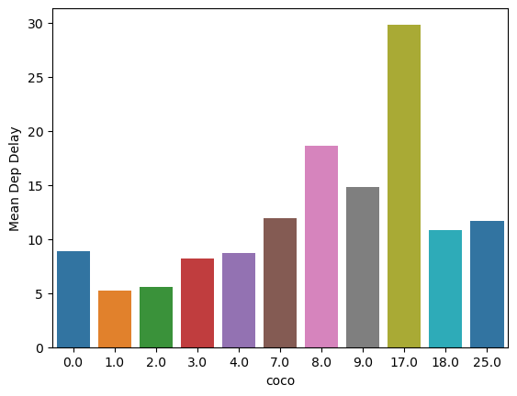
Rain showers led to the most delayed departures!
Categories

Slide 5
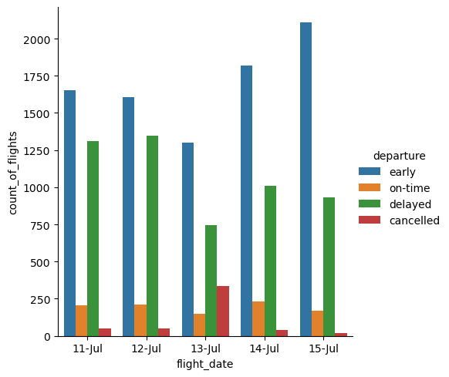
Hurricane Barry affected the most on 13th July

Slide 6
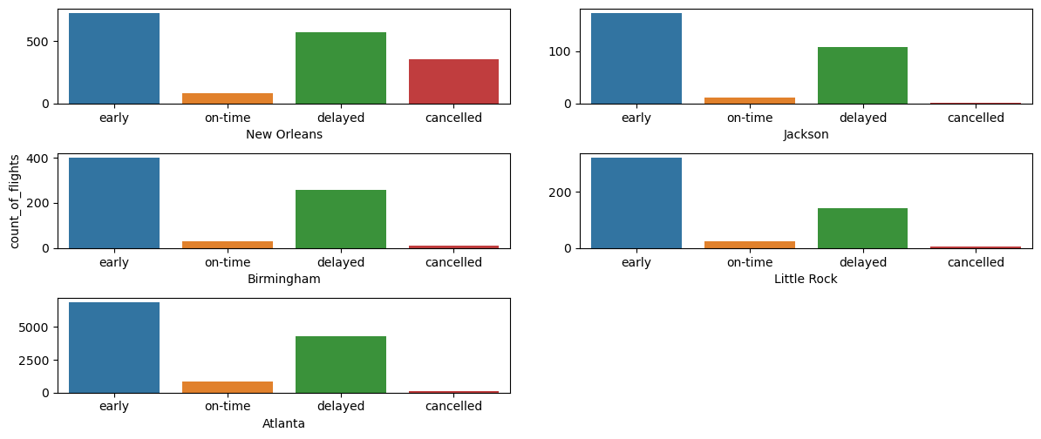
New Orleans is most affected with Hurricane Barry

Slide 7
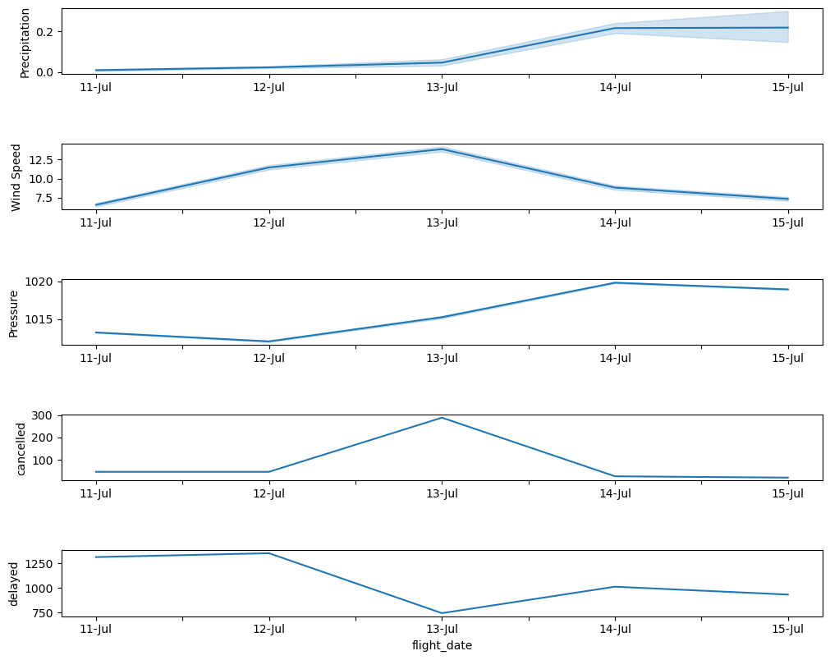
Weather trend speaks!
Notes:
12 Jul - 13 Jul
Light Precipitation
Wind Speed started to increase
Air Pressure at sea level started to increase
Flights were cancelled
13 Jul - 14 Jul
Precipitation increases
Wind Speed started decreasing
Air Pressure at sea level still increasing
Flights not cancelled but delayed
14 Jul - 15 Jul
Precipitation constant
Wind Speed started decreasing
Air Pressure at sea level also started decreasing
Flights status improves

Slide 8
Going through the notebook for creating weather table

Slide 9
Thank you for your attention!

